Slide 1

Basic Angular
Nook

Slide 2
Overview
Intro
Architecture
Basic Typescript

Slide 3
Intro
By Google and Microsoft
V 4.0.3 (Current)

Slide 4
Require
nodeJS (https://nodejs.org/en/) use NPM to manage Package
HTML, CSS
Command Line
Basic Typescript, is compile to JavaScript

Slide 5
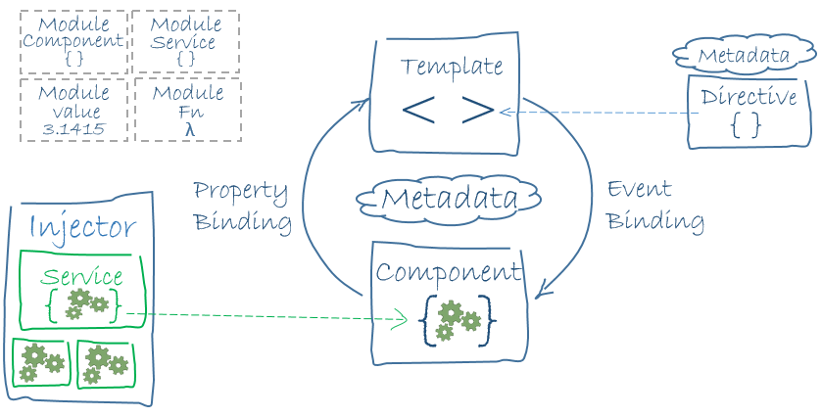
Architecture

Slide 6
Architecture (con.)
Module
Component
Data Binding

Slide 7
Start Application
git clone https://github.com/angular/quickstart.git quickstart
cd quickstart
npm install
npm start

Slide 8
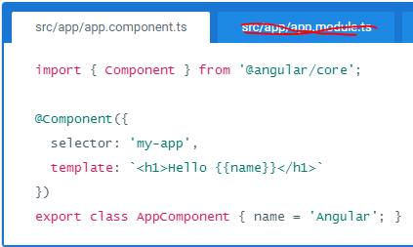
Component
app.module.ts

Slide 9
TUTORIAL: TOUR OF HEROES
https://angular.io/docs/ts/latest/tutorial/toh-pt1.html

Slide 10
Assignment

Slide 11
Thank you
Official : https://angular.io/
Thai : http://wp.curve.in.th/angular-1

